Slide 1

QUADTREE VISUALIZER
Major Project
Department of Computer Engineering
TERNA ENGINEERING COLLEGE
Nerul (W), Navi Mumbai 400706
REVIEW PRESENTATION
Group ID: PHI – CS 73
Group Members:
Under the Guidance of : Prof. Randeep Kaur Kahlon
Amey Thakur
Hasan Rizvi
Mega Satish
Ajay Davare
B-50
B-51
B-58
B-01

Slide 2
QUADTREE VISUALIZER
Major Project
Project by:
AMEY THAKUR | TE COMPS B-50 | TU3F1819127
HASAN RIZVI | TE COMPS B-51 | TU3F1819130
MEGA SATISH | TE COMPS B-58 | TU3F1819139
AJAY DAVARE | TE COMPS B-01 | TU3F1718006

Slide 3
An application capable of presenting a view of the QuadTree.
Design and development of QuadTree view and data model.

Slide 4
ABSTRACT
Develop a program that can show a QuadTree view and data model architecture using a single global library.
Many digital map applications have the need to present large quantities of precise point data on the map. Such data can be weather information, the population in towns, etc. With the development of Internet of Things, we expect such data will grow at a rapid pace. How to visualize such magnitude of data on mobile devices and web browsers becomes a problem.
This project aims to build an efficient library for interactively visualizing such data, using a combination of grid-based clustering and hierarchical clustering, along with quadtree spatial indexing.

Slide 5
OBJECTIVES
This project's objective is to provide a single global library that can be shared, reused, and readily accessed.
Quadtree aims to be:
Versatile (can be used in dynamic and static contexts)
Simple
Lightweight
Easy to use
Fast
Header only
Implemented with modern C/C++ features

Slide 6

LITERATURE SURVEY
QuadTree is dead!!
TYPES – Point Quadtree, Edge Quadtree, Polygonal Map QuadTree.
All forms of quadtrees share some common features:
They decompose space into adaptable cells.
Each cell (or bucket) has a maximum capacity. When maximum capacity is reached, the bucket splits.
The tree directory follows the spatial decomposition of the quadtree.
So to speak in layman’s term, A quadtree is a tree whose nodes either are leaves or have 4 children. The children are ordered 1, 2, 3, 4.
I’m Dead, Now What?

Slide 7
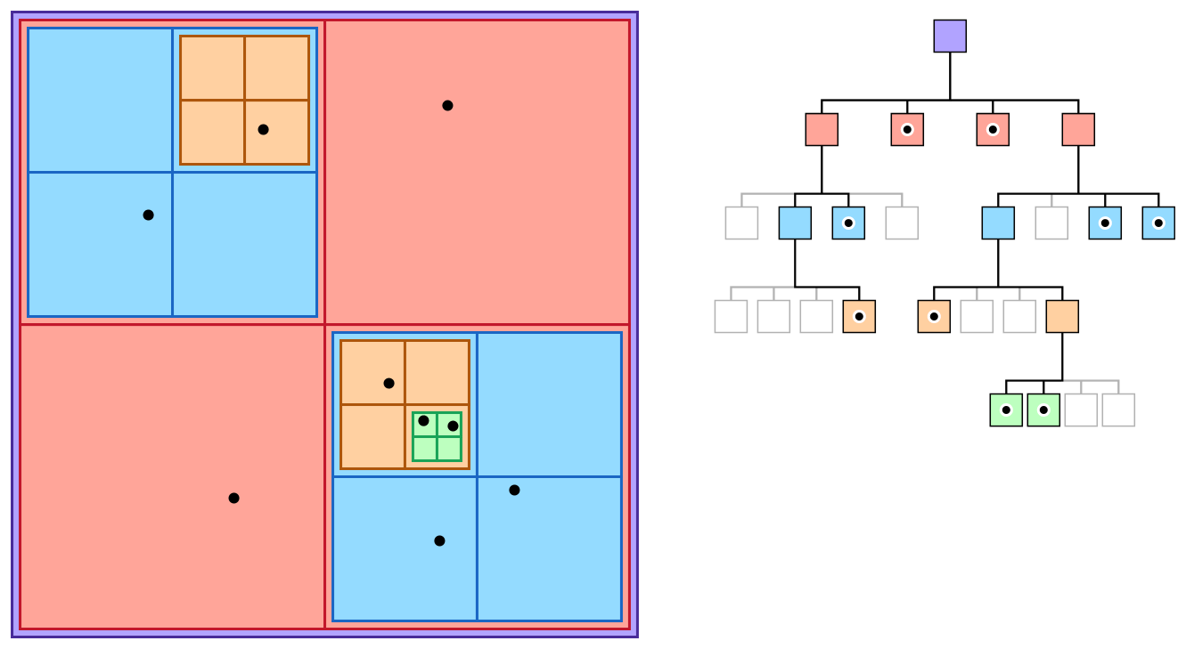
INTRODUCTION
What is QuadTree?
A data structure for organizing objects based on their locations in a two-dimensional space.

Slide 8
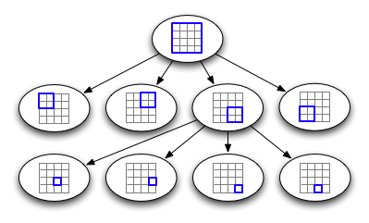
A similar partitioning is also known as a Q-tree.
The quadtree partitioning strategy divides space into four quadrants at each level. When a quadrant contains more than one object, the tree subdivides that region into four smaller quadrants, adding a level to the tree.

Slide 9
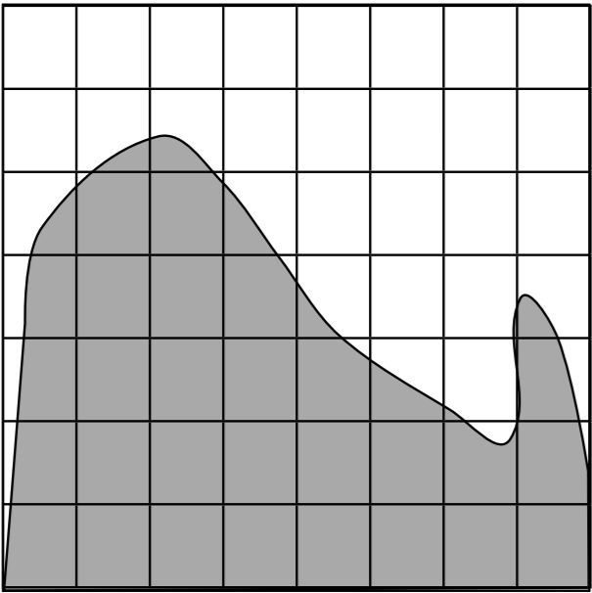
How does QuadTree Works?
Subdivide into uniform blocks

Slide 10
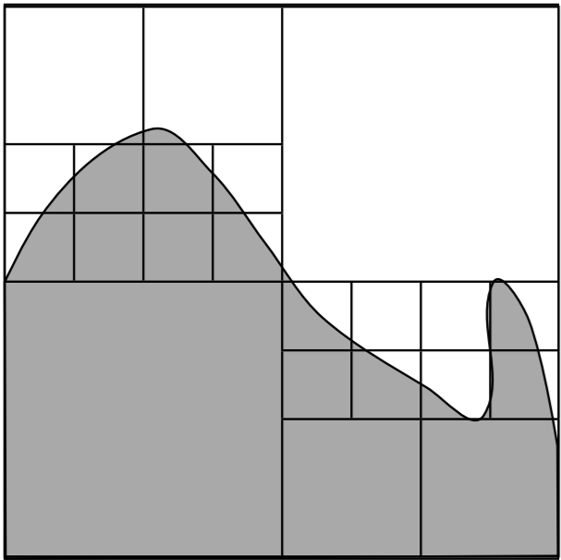
How does QuadTree Works?
Subdivide into uniform blocks
Merge Similar Brothers

Slide 11
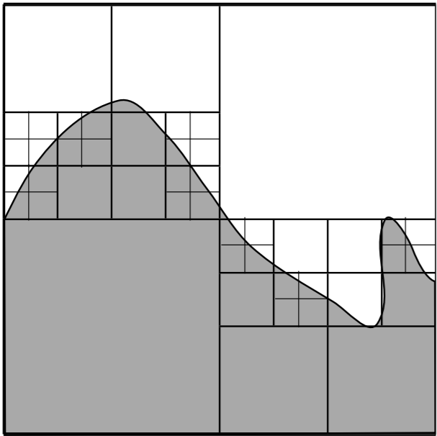
How does QuadTree Works?
Subdivide into uniform blocks
Merge Similar Brothers
Subdivide Non-homogenous Cells

Slide 12
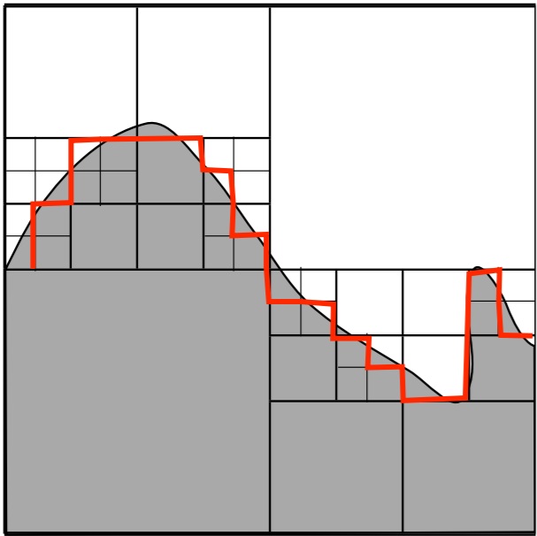
How does QuadTree Works?
Subdivide into uniform blocks
Merge Similar Brothers
Subdivide Non-homogenous Cells
Group Identical Blocks
to get regions

Slide 13
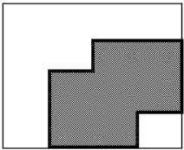
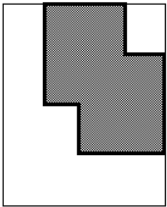
LIMITATIONS OF QUADTREE
The main disadvantage of quadtrees is that it is almost impossible to compare two images that differ only in rotation or translation. This is because the quadtree representation of such images will be so totally different.
The algorithms available for rotation of an image are restricted to rotations of 90 degrees (or multiples thereof). No other rotation is available, nor is there a facility for translation.
First Image
Rotated Image

Slide 14
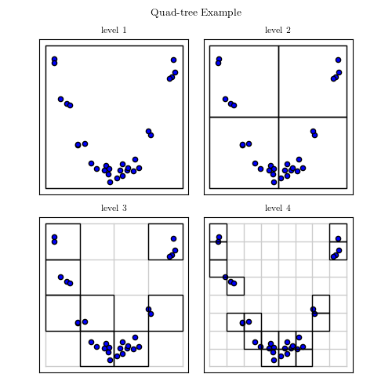
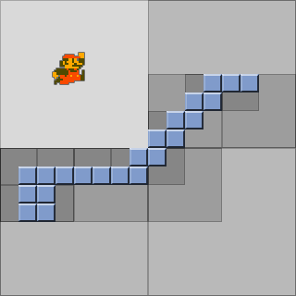
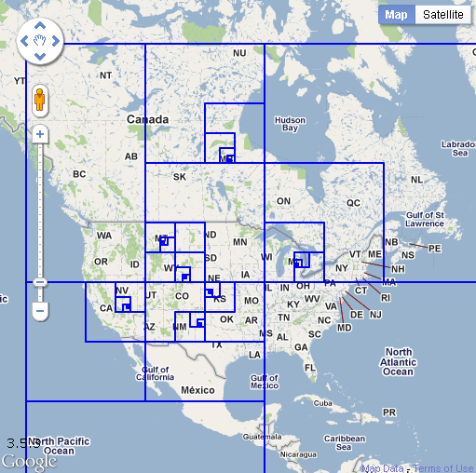
APPLICATIONS OF QUADTREE DATA STRUCTURE
Computer Graphics, Games, Movies
Computer Vision, CAD, Street Maps (Google Maps/Google Earth)
Human-Computer Interface Design (Windowing Systems)
Virtual Reality
Visualization (Graphing Complex Functions)

Slide 15
QuadTree Compression of an image step by step
Left shows the compressed image with the tree bounding boxes while the right shows just the compressed image.

Slide 16
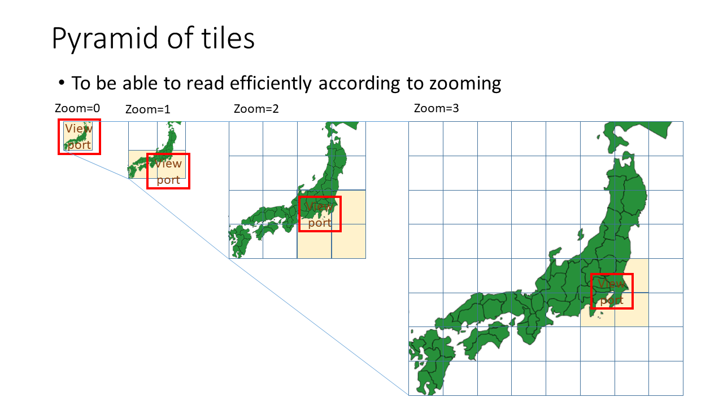

Slide 17

THE BIG BANG MODEL
TIME
QuadTree
Library
BIG BANG
EFFORTS
RESOURCES

Slide 18
TOOLS AND TECHNOLOGIES USED
TOOLS USED
GitHub Pages
CMake
Visual Studio Code
TECHNOLOGIES USED
C/C++ Language

Slide 19
PROJECT PLAN
# | Task | Start Date | End Date
1 | Understand Object-Oriented Programming in C | 17-09-2021 | 01-10-2021
2 | Understand Design Patterns in C | 01-10-2021 | 15-10-2021
3 | Learn how to use TinyXml | 15-10-2021 | 29-10-2021
4 | Define ADT for QuadTree | 29-10-2021 | 12-11-2021
5 | Define the file format for QuadTree | 12-11-2021 | 26-11-2021
6 | Get your hands on the pcf_ui library | 26-11-2021 | 10-12-2021
7 | Understand the Drawing View Control of pcf_ui | 10-12-2021 | 24-12-2021
8 | Sequence diagram for your final application | 24-12-2021 | 08-01-2022
9 | Implement the Visualizer | 08-01-2022 | 05-02-2022
10 | Design the architecture of the application | 05-02-2022 | 12-02-2022

Slide 20
REFERENCES
Q. Cai and Y. Zhou, "A quadtree-based hierarchical clustering method for visualizing large point dataset," 2016 Sixth International Conference on Information Science and Technology (ICIST), 2016, pp. 372-375, doi: 10.1109/ICIST.2016.7483441.
“An effective way to represent quadtrees” Communications of the ACM, Volume 25, Issue 12, Dec 1982 pp 905–910, doi:10.1145/358728.358741
“Optimal quadtree construction algorithms” Computer Vision, Graphics, and Image Processing, Volume 37, Issue 3, March 1987, pp 402–419, doi:10.1016/0734-189X(87)90045-4

Slide 21
THANK YOU

